Slide 1
Random Number Generator

Slide 2
Introduction to Random Number
Where to Random Number
  Simulation
    Evaluation of algorithm in noisy environment
    Example: Pattern recognition, Communication
  Game
    Random sequence generation for items
Random Number
  Most modern computers do not generate truly random sequences, rather they can be programmed to produce pseudo-random sequences
  Uncorrelated RN with infinite period

Slide 3
Uniform Random Number
Fall within specific interval, usually [0,1]
  Equally probable or likely
  Maximal entropy condition
Any other type of random number can be generated from this uniform random number
  Theoretically important
Any modern computer provides the built-in function
  rnd(); uniform from 0 to RANDMAX-1

Slide 4
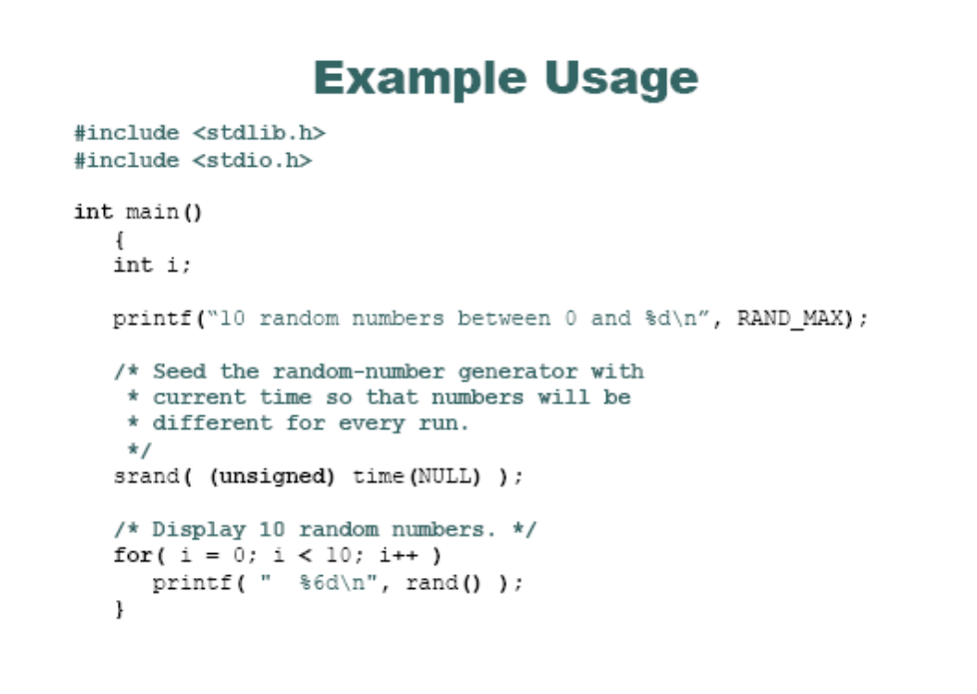
Uniform Random Number
Seed of random number:
Initial value of shift register to generate uniform random number
Uniform random number in [min, max]
rand = ((max-min)/(RAND_MAX -1))*rand() - min

Slide 5
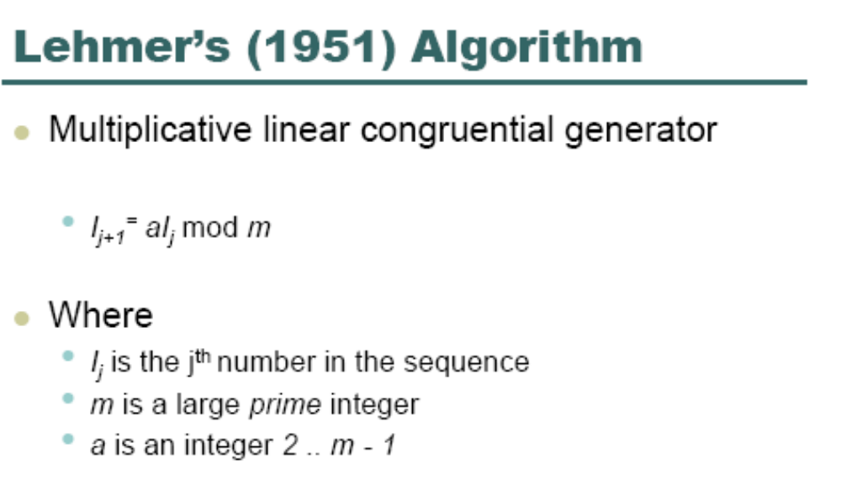
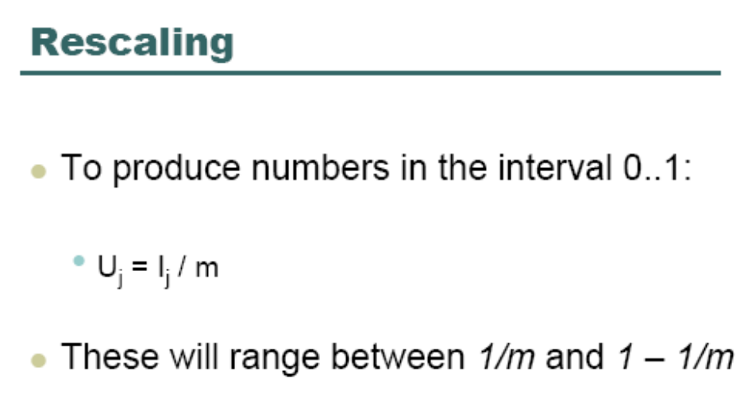
Uniform Random Number

Slide 6
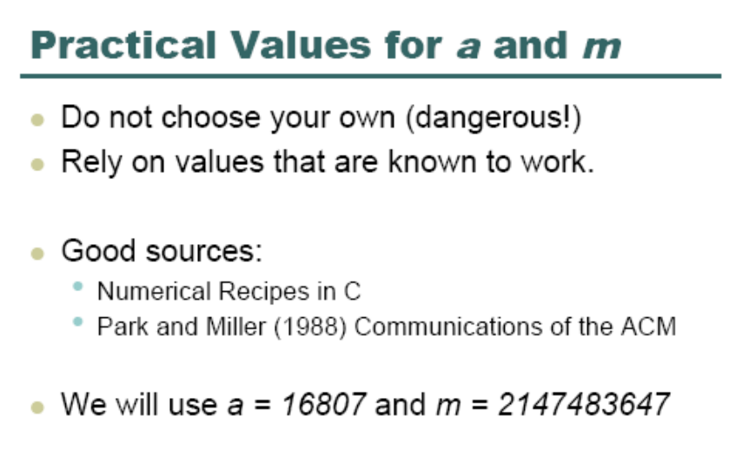
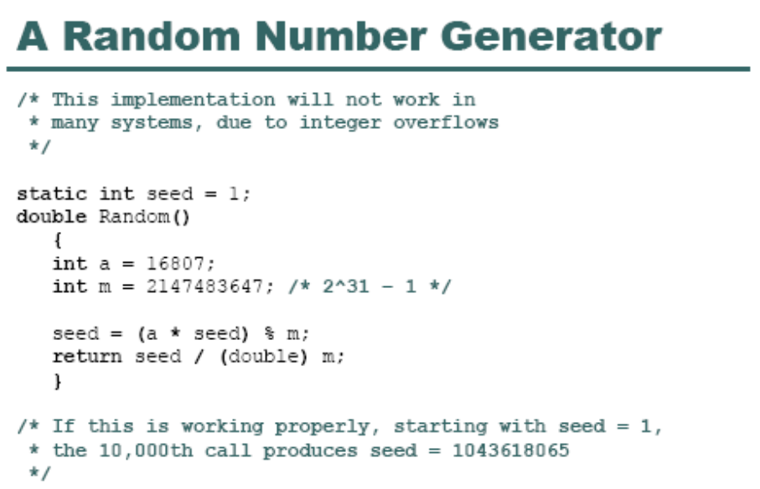
Uniform Random Number

Slide 7
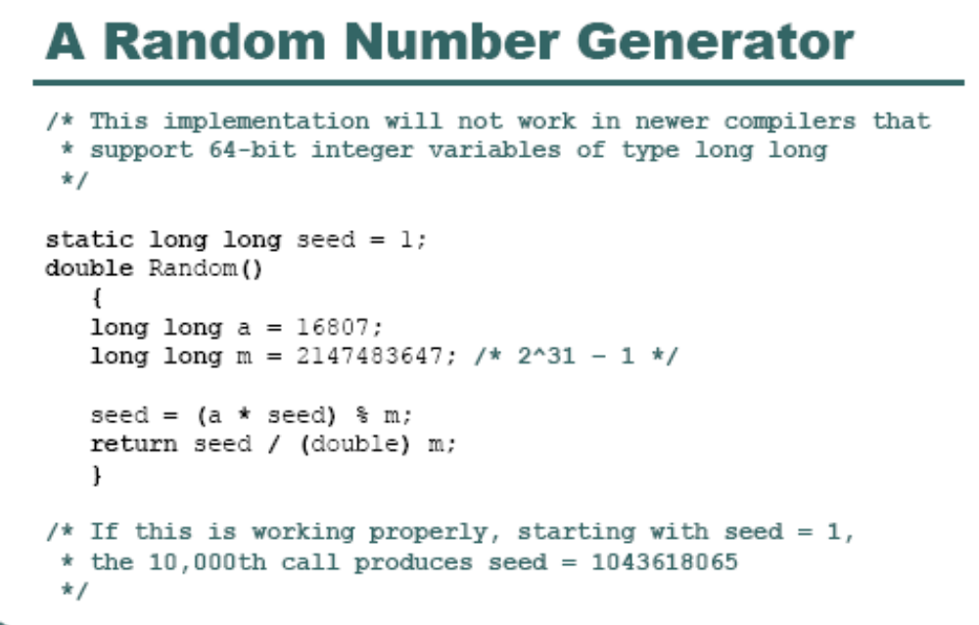
Uniform Random Number

Slide 8
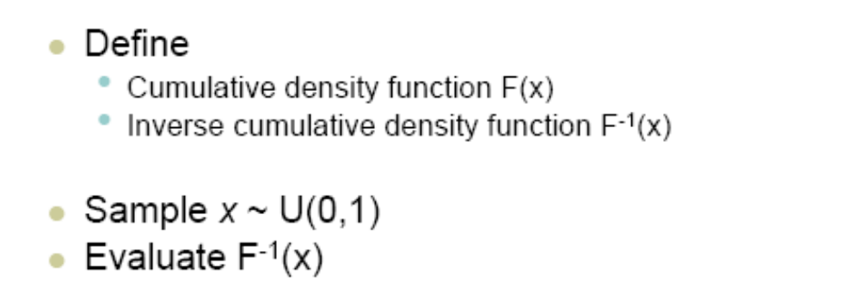
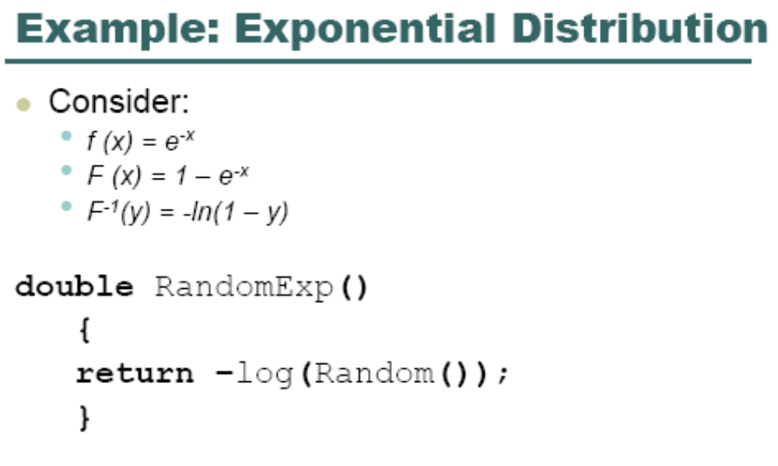
Arbitrary Distributed Random Number

Slide 9
Gaussian Random Number
Box-Muller transformation for normal distribution
  float x1, x2, w, y1, y2;
  do {
  x1 = 2.0 * random() - 1.0; random is uniform on [0,1]
  x2 = 2.0 * random() - 1.0;
  w = x1 * x1 + x2 * x2;
  } while ( w >= 1.0 );
  w = sqrt( (-2.0 * ln( w ) ) / w );
  y1 = x1 * w; /normal distribution with mean 0 and std 1
  y2 = x2 * w; /normal distribution with mean 0 and std 1

Slide 10
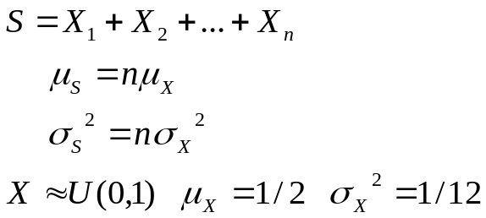

Gaussian Random Number
Central Limit Theorem
  Sum of independent identically distributed random variable approaches Gaussian r.v
  Gaussian different mean and standard deviation
REAL x,m,s,uniform
INTEGER i
x = 0.0
DO i = 1,12
 | CALL RANDOM ( uniform ) x = uniform + x
ENDDO
x = s * ( x - 6.0 ) + m
END

